Slide 1
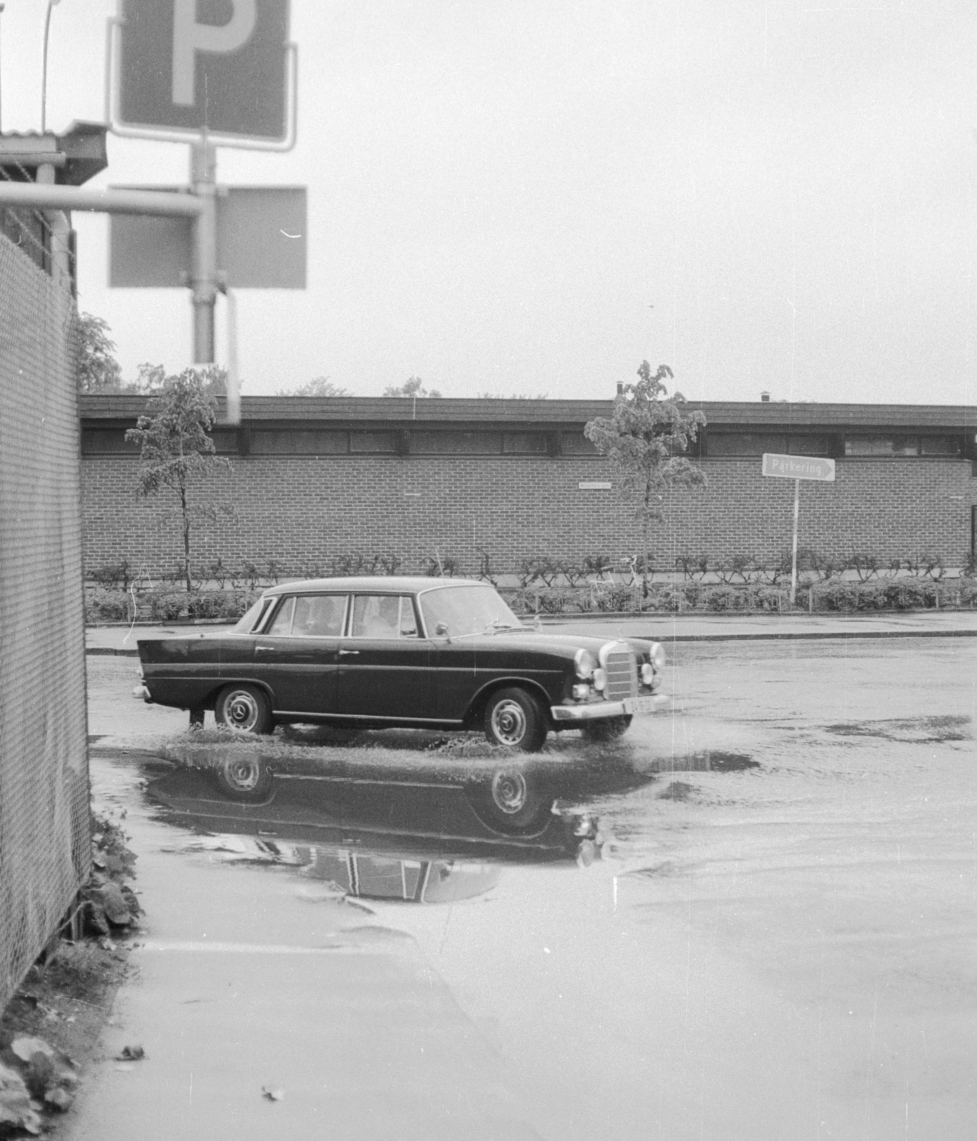
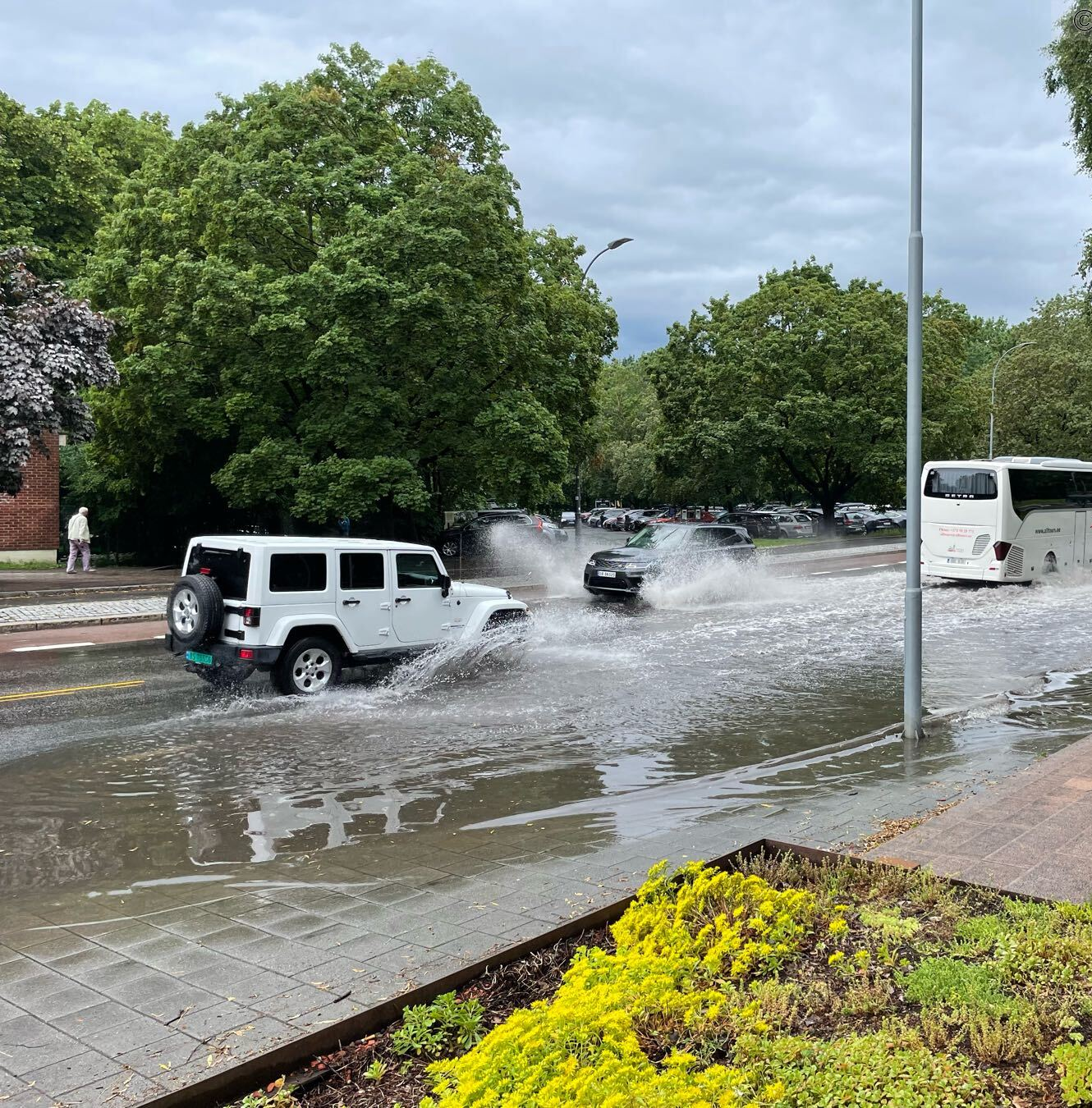
ECCO WP3-Hydrological modelling
Thomas Skaugen, Anne Fleig, Deborah Lawrence Danielle Barna, Tiia Pedusaar + +
June 1972, Foto: Henrik Svedahl, NVE
July 2022, Foto: Bjørn Lytskjold, NVE
Notes:
Hvorfor er dette viktig?
For å unngår problemer og skader pga av vann på avveie. Det kan være overvann i en gate sånn som her foran M29 i juli eller et urbant vassdrag som går over sine bredder.
Viktig at man vet omtrent, hvor mye vann som må forventes for å kunne planlegge for det, f.eks. dimensjonering av infrastruktur som skal håndtere vannet og også i arealplanlegging.
Er det noe nytt?
Nei, egentlig ikke. Utfordringen fantes også tidligere. Her samme kryss, men 50 år tidligere i juni 1972.
Prosjektet har flere arbeidspakker. Men i dag skal jeg i hovedsak snakke om arbeidet med dimensjonerende nedbør.
I urbane områder mest den korte intense nedbøren som oftest fører til oversvømmelse, fordi det handler ofte om små nedbørfelt med stor andel tette flater.
Dette fører til at nedbørfeltet har litte evne til å holde tilbake vann. Og da blir det fort en oversvømmelse, hvis det kommer mye vann samtidig.
Per i dag er den anbefalte metoden for å finne dimensjonerende nedbør til å gå på nettsidene fra Klimaservicesentret og …

Slide 2
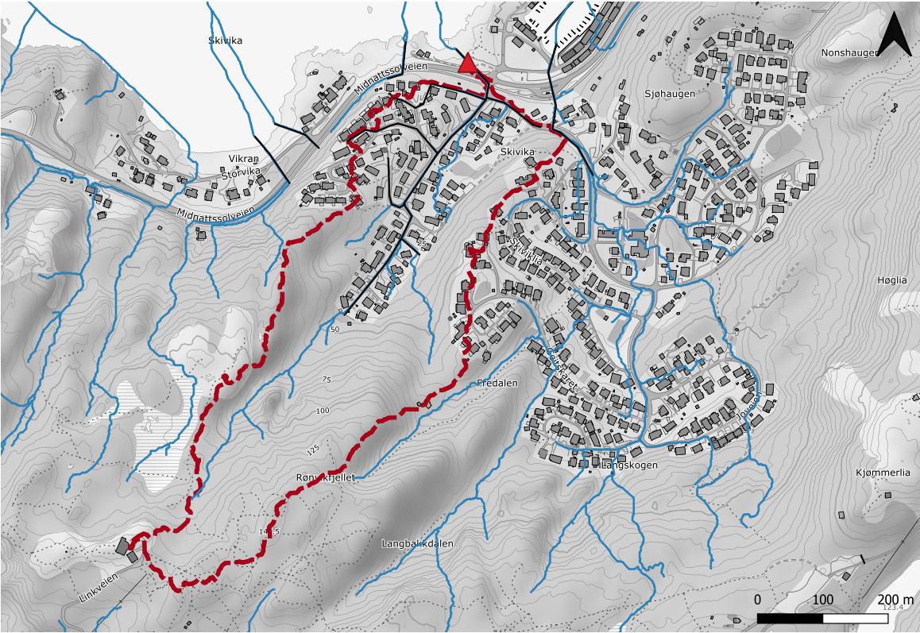
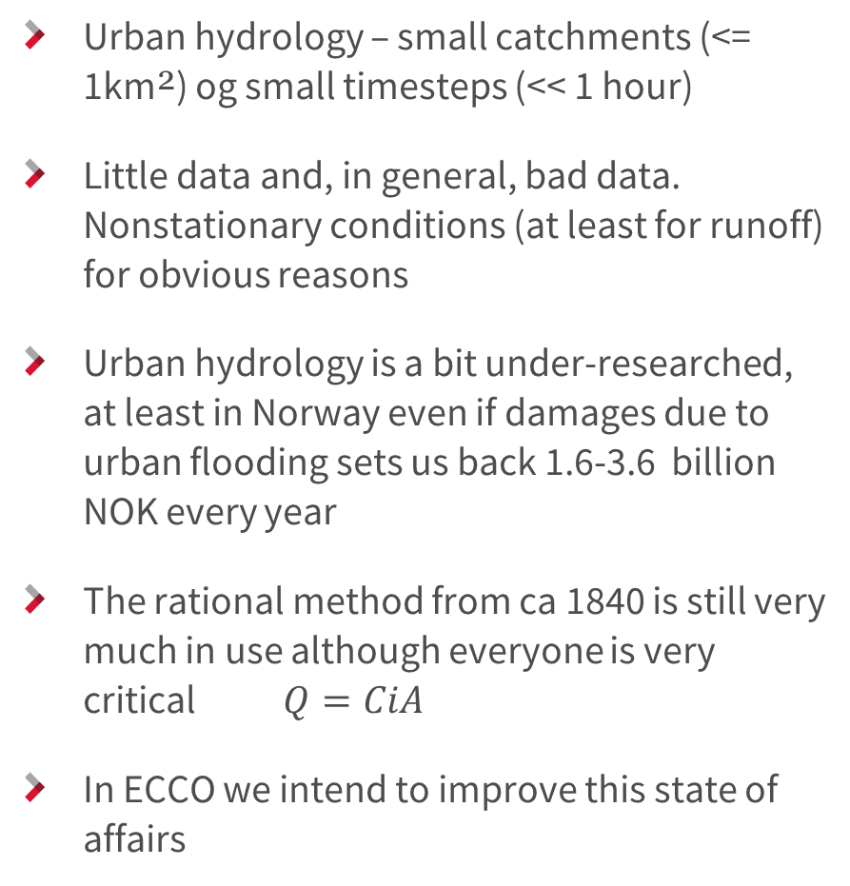
Urban hydrology
Skivika in Nordland
Urban hydrology – small catchments (<= 1km²) og small timesteps (<< 1 hour)
Little data and, in general, bad data. Nonstationary conditions (at least for runoff) for obvious reasons
Urban hydrology is a bit under-researched, at least in Norway even if damages due to urban flooding sets us back 1.6-3.6 billion NOK every year
The rational method from ca 1840 is still very much in use although everyone is very critical$Q=CiA$
In ECCO we intend to improve this state of affairs
v = 1,0 m/s
v = 0,00001 m/s

Slide 3
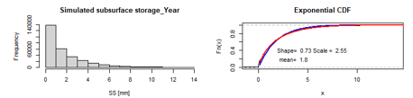
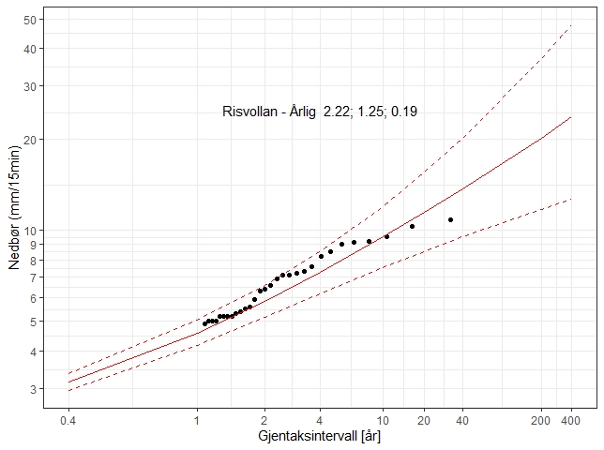
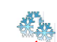
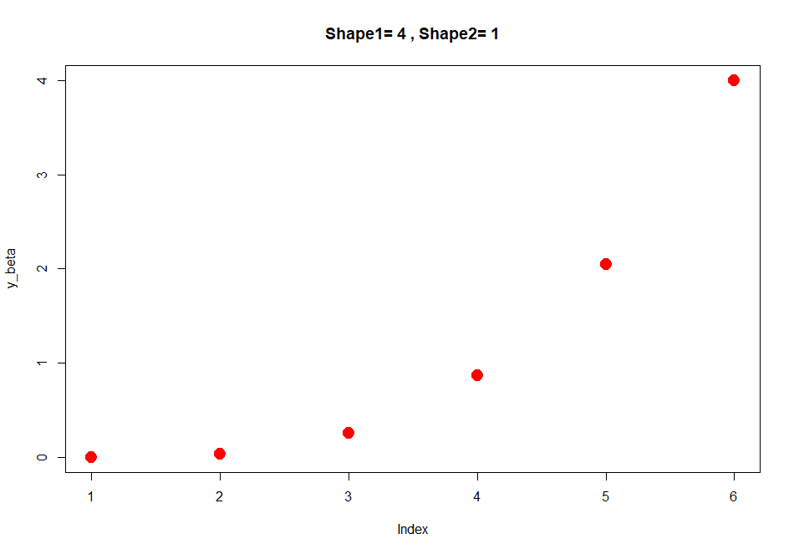
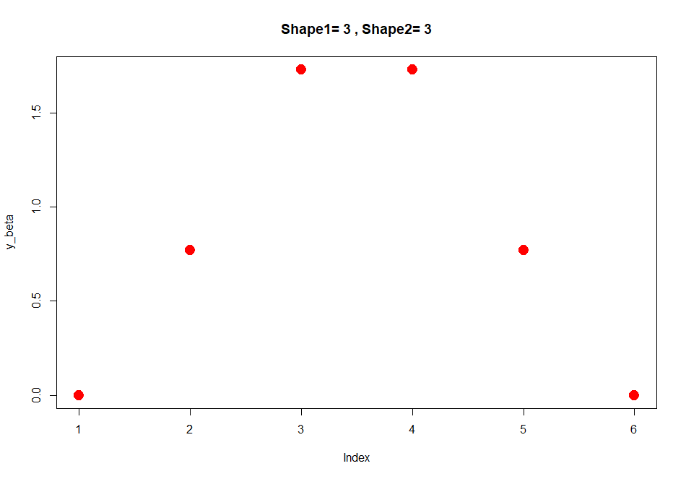
Floods in urban areas - what is important?
How wet is it before the precipitation /snowmelt event- how is the antecedent moisture condition (AMC)?
Extreme precipitation of the correct duration (=time of concentration, Tc)
Snowmelt
Temporal distribution of precipitation- the rainfall pattern
Correlation patterns

Slide 4
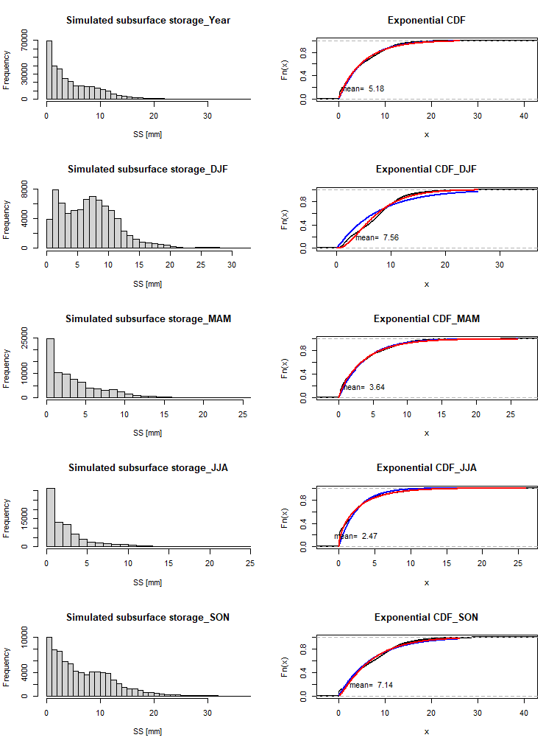
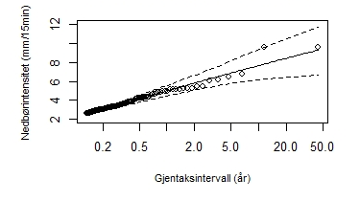
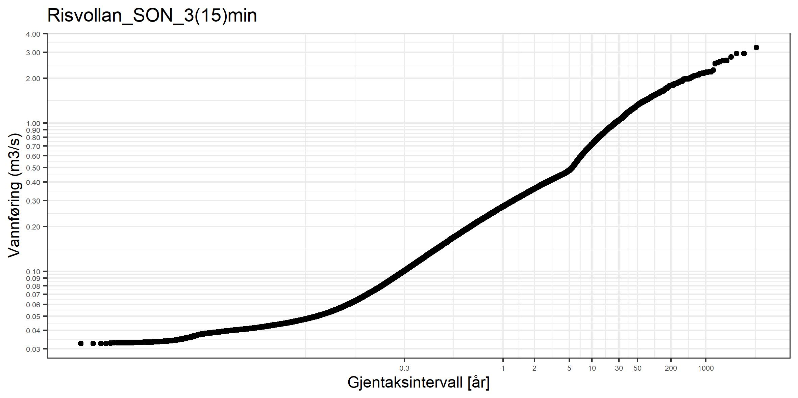
Method 1: Stochastic simulation of floods – DDDEvent
Stochastic 1: wetness, AMC
Stochastic 2: extreme precipitation
DDDEvent
Stochastic 3: rainfall pattern

Slide 5
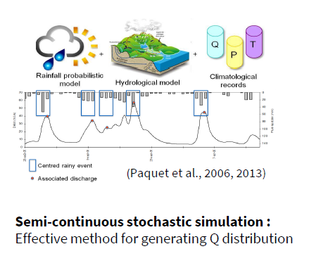
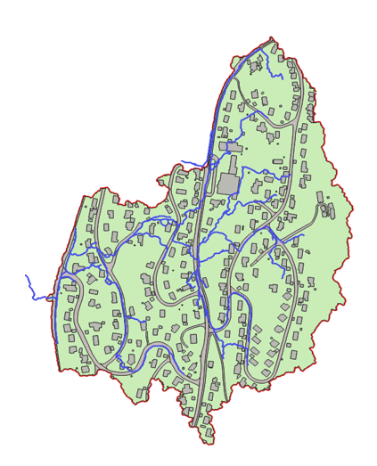
Method 2: SCHADEX with DDDv2, a much more complete- but also more demanding hydrological model than DDDEvent.
Precipitation, temperature and
snow routine per elevation zone i
Pi
Ti
DDD
TX, U, pro
snowfall
rainfall
Snow accumulation-
and melt distribution
SWE re-freezing
snowmelt
Permeable area, Parea
Impermeable area, Iparea (1-Parea)
InfCap_P >> InfCap_IP
InfCap_P
Evap.
InfCap_IP
Evap.
Soil UZ_P
Soil UZ_IP
recharge
recharge
Soil SZ_P
QOF
QOF
Soil SZ_IP
Soil and response
routine
Q4
Q4
M
Q3
Gsc
Q3
Q2
Q2
Q1
Q1
rv
Q

Slide 6
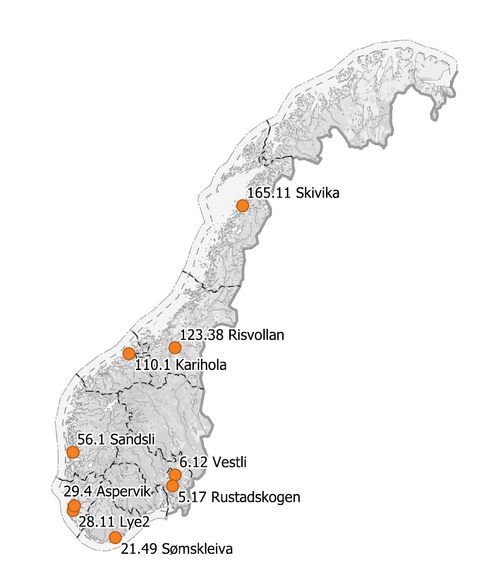
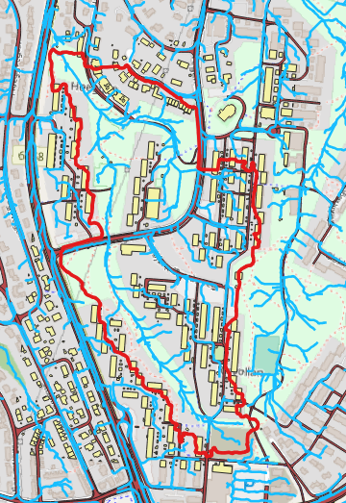
One of the study areas: Risvollan (Trondheim, Norway)
Risvollan
Area: 0.18 km²
Permeable (P): 78 %
Impermeable (IP): 22 %
Runoff data and precipitation data from way back (1987-dd). Quality not great, 5 min resolution.

Slide 7
Method 1: Temporal distribution of antecedent moisture conditions- AMC
We use a rainfall- runoff model which include urban areas, the DDDv2
-Permeable areas
-Impermeable areas
-Infiltration capacity
The model stores
subsurface moisture states
(and overland flow)
DDDv2
Precipitation, temperature and
snow routine per elevation zone i
Pi
Ti
TX, U, pro
snowfall
rainfall
Snow accumulation-
and melt distribution
SWE re-freezing
snowmelt
Permeable area, Parea
Impermeable area, Iparea (1-Parea)
InfCap_P >> InfCap_IP
InfCap_P
Evap.
InfCap_IP
Evap.
Soil UZ_P
Soil UZ_IP
recharge
recharge
Soil SZ_P
QOF
QOF
Soil SZ_IP
Soil and response
routine
Q4
Q4
M
Q3
Gsc
Q3
Q2
Q2
Q1
Q1
rv
Q

Slide 8
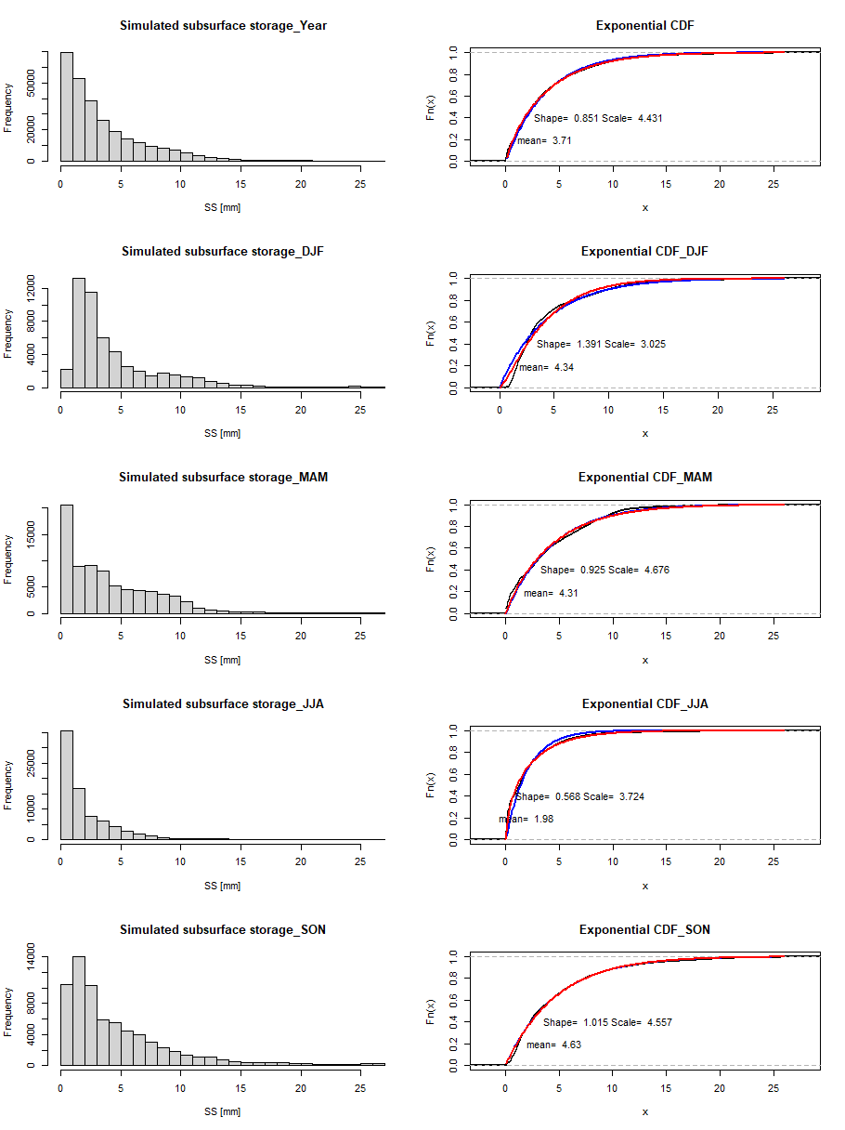
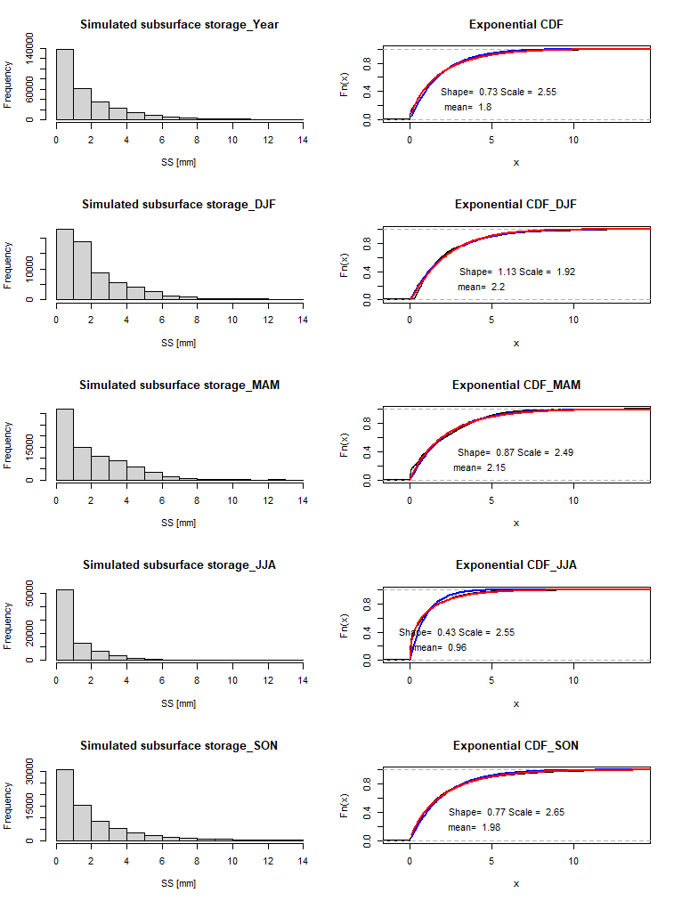
It turns out that this step is very important- DDDv2 needs a careful calibration
December 2023
January 2024
-Close inspection of recessions (celerities)
-Calibrating for April-September
instead of winter gives us a better calibrated subsurface response
- We transfer parameters from DDD to the stochastic DDDEvent,
celerites, pkorr, etc
Big difference in AMC distributions
after careful calibration

Slide 9
We use a gamma distribution for AMC Anderson- Darling (AD) , Kolmogorov –Smirnov (KS)
 |  | Gamma | LogNormal | Exponential
Annual
 | AD | 1716.8 | 14420.64 | 6222.2
 | KS | 0.061 | 0.157 | 0.077
DJF
 | AD | 638.04 | 102.83 | 961.68
 | KS | 0.066 | 0.03 | 0.095
MAM
 | AD | 1311.54 | 4798.11 | 3359.6
 | KS | 0.085 | 0.167 | 0.118
JJA
 | AD | 252.16 | 3050.99 | 8093.49
 | KS | 0.063 | 0.14 | 0.185
SON
 | AD | 225.21 | 2567.6 | 748.66
 | KS | 0.042 | 0.124 | 0.06

Slide 10
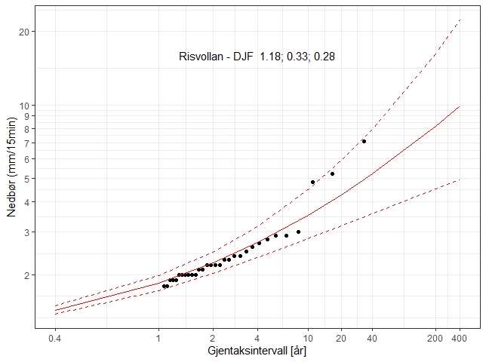
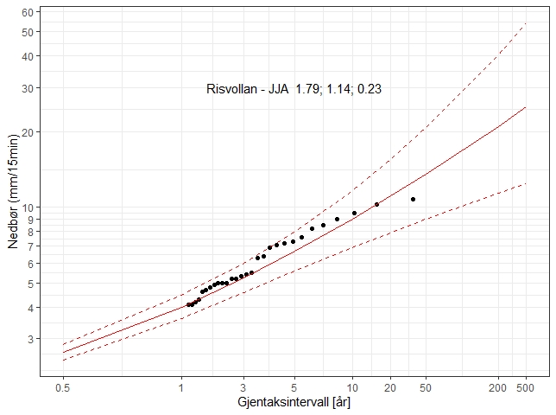
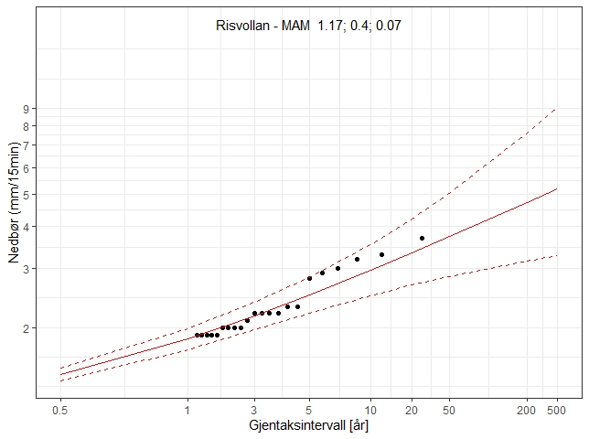
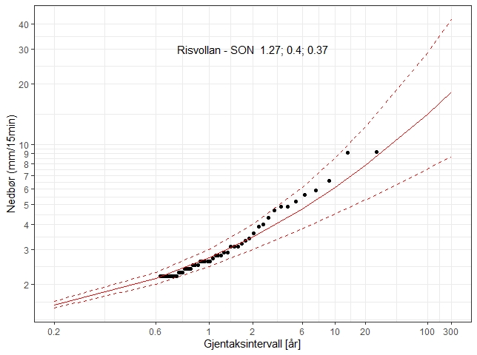
Method 1, 2: Extreme precipitation (15 min duration) – General Pareto Distribution

Slide 11
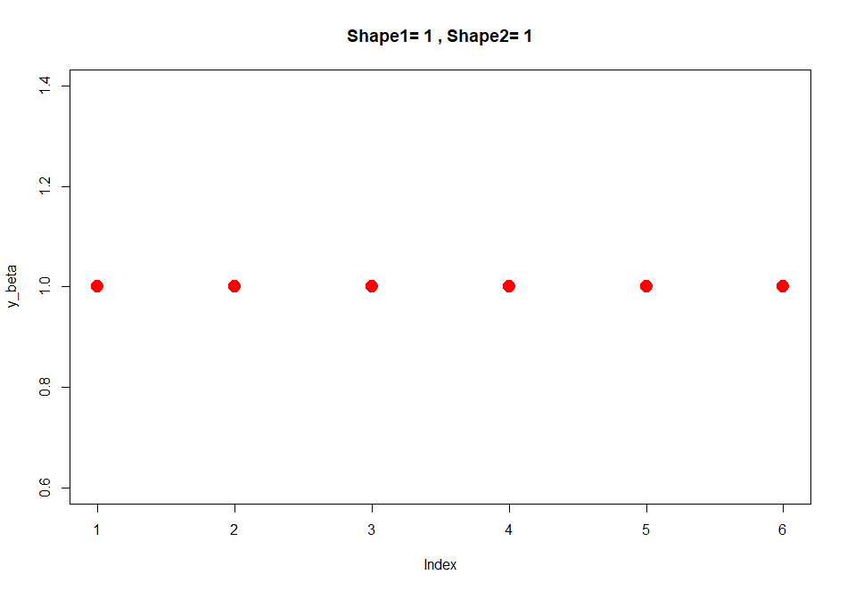
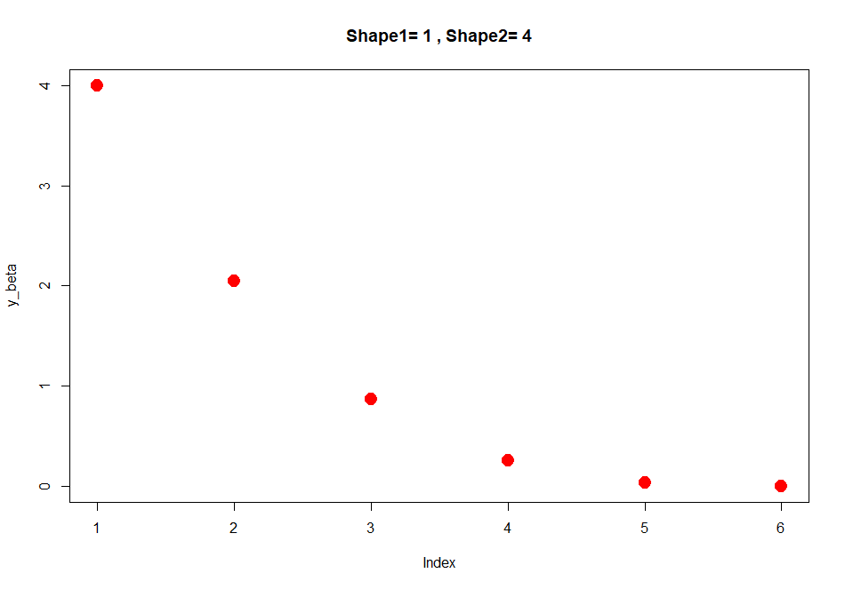
Method 1 (2): Rainfall-pattern- beta distributed

Slide 12
Extreme rainfall, disaggregated to Model timestep
Duration of extreme precip > Model timestep
Method 1: DDDEvent
- run many (100000) timeseries of short duration using drawn subsurface states
- length of timeseries is twice time of concentration to include the recession period
For Risvollan this becomes 10 timesteps of 3 minuttes
ICapP >> ICapIP
Permeable area, P-area
Impermeable area, IP-area (1 - P-area)
ICapP
ICapIP
Soil_P
QOF
QOF
Soil_IP
M
Gsc
QSS
QSS
rv
Q

Slide 13
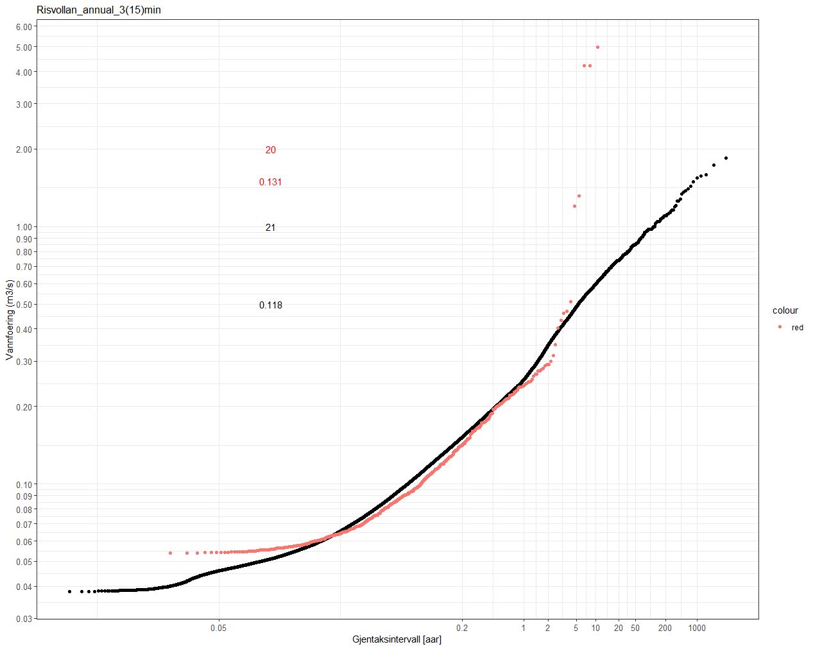
Method 1: Risvollan runoff 1987-2022. Temporal resolution 5 min. Red observed - black simulated
Flooding of station at 0.4 m3/s

Slide 14
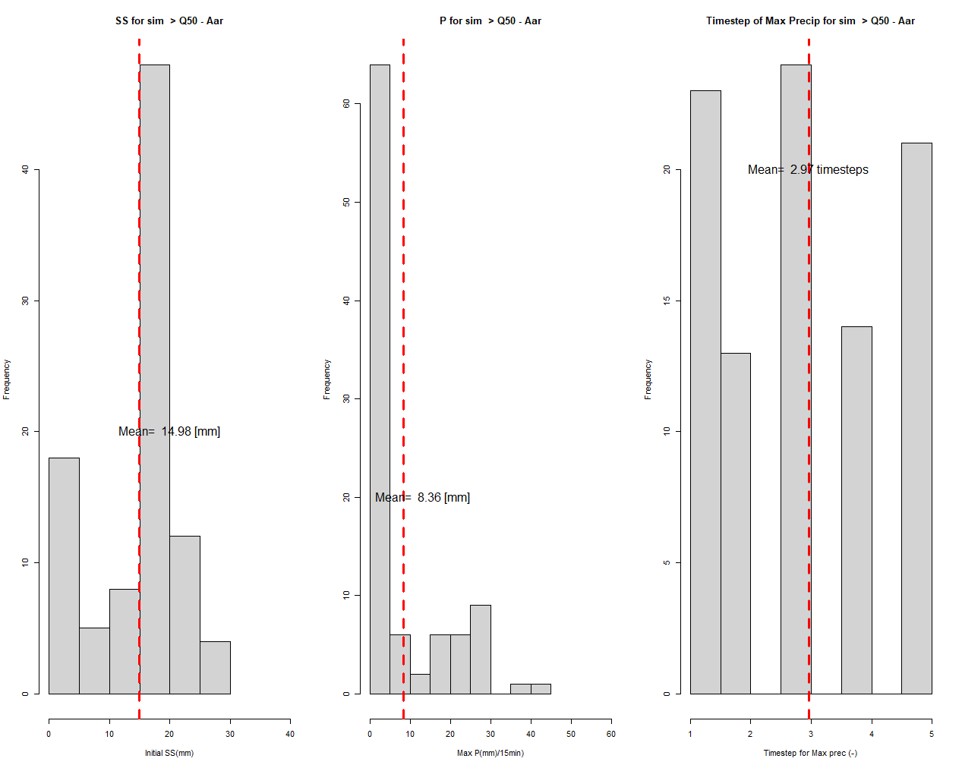
Method 1: 50 yr flood, precipitation and antecedent moisture conditions (AMC). Complete subsurface saturation @13.0 mm
5 years

Slide 15
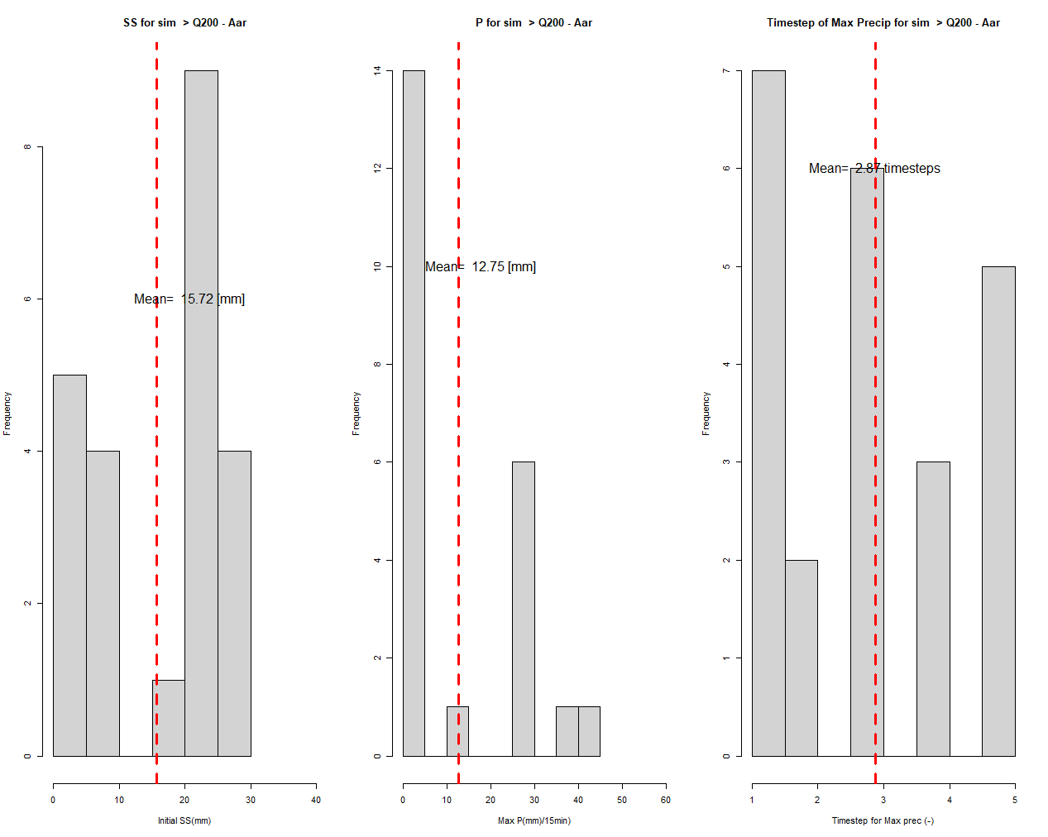
Method 1: 200 yr flood, precipitation and antecedent moisture conditions (AMC). Complete subsurface saturation @13.0 mm
27 years

Slide 16
However,
What kind of runoff values are simulated with this procedure-
are they extreme values?
Is it possible to associate return periods and plot them using
plotting positions?
Don’t see how. Due to varying antdedent moisture conditions
almost any runoff value can happen – even for extreme precipitation
Need a rethink
We try an exploratory approach –
what happens (runoff wise) when a 2,5, 10, 50 100, 200 year
precipitation event happens?

Slide 17
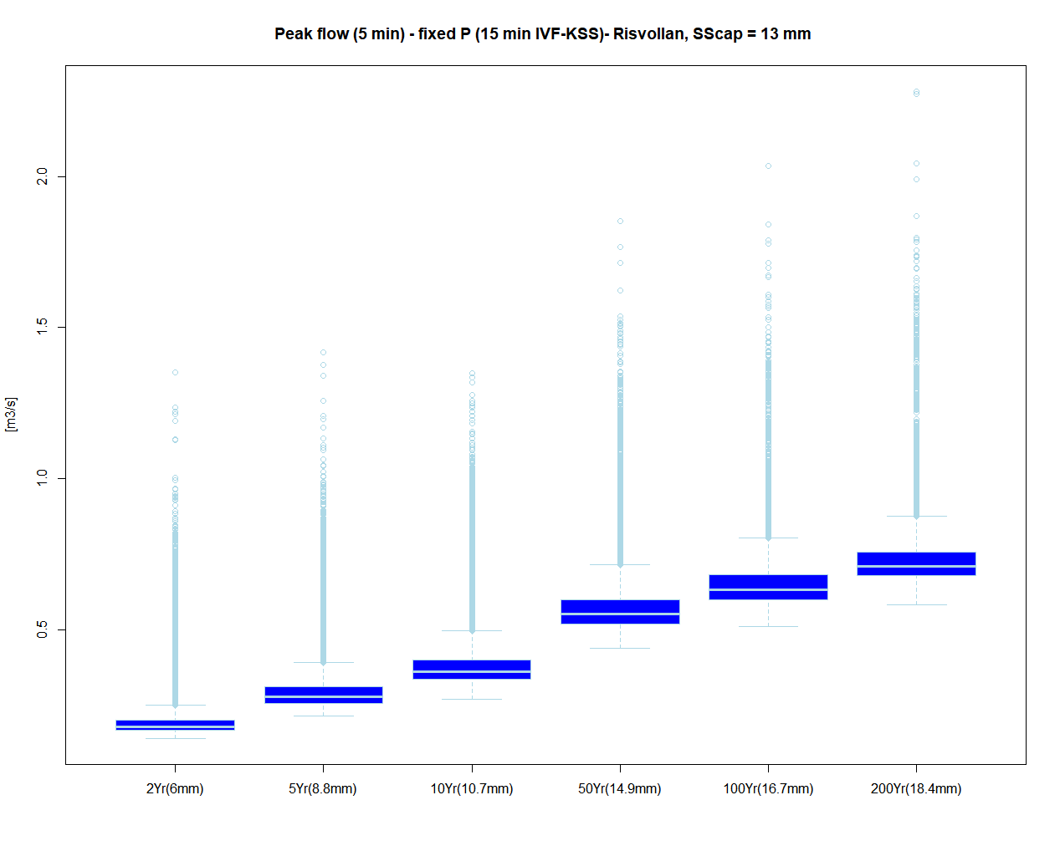

Slide 18
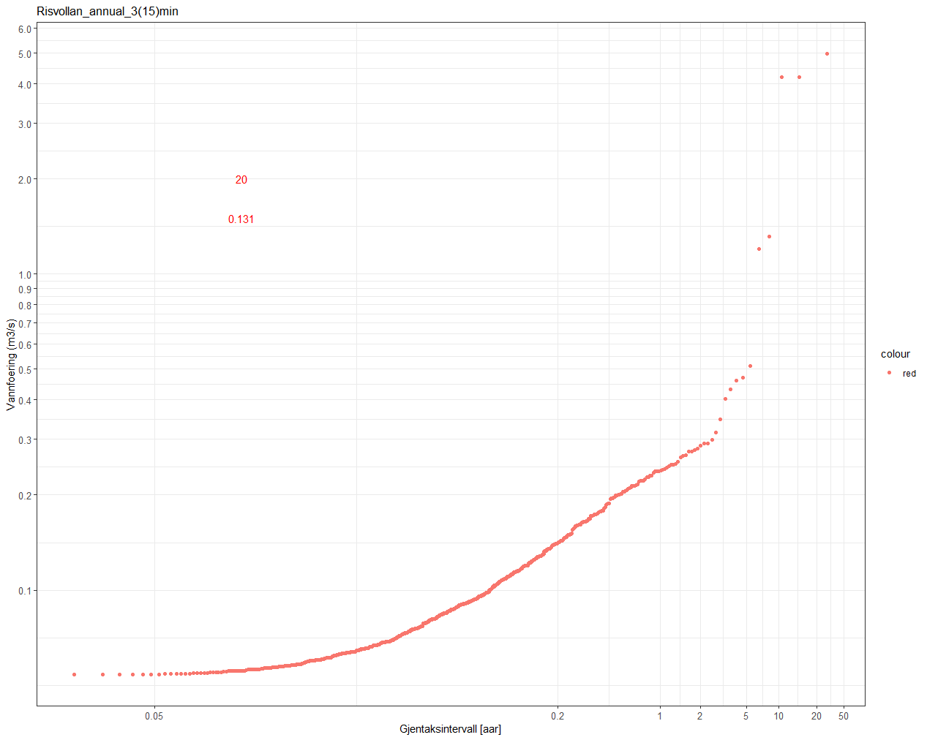
Hva er flomverdiene på Risvollan?
Rasjonelle metode:
180 000 m2, tc = 15 min = 900 sekunder
C = 0.7 (NVE, 10, 1997)
P2y (tc) = 6 mm
P5y (tc) = 8.8 mm
P10y (tc) = 10.7 mm
P50y (tc) = 14.9 mm
Q2Y = 0.7*0.006*180000/900=0.84 m3/s
Q5Y= 0.7*0.0088*180000/900=1.23 m3/s
Q10Y = 0.7*0.0107*180000/900=1.5 m3/s
Q50Y = 0.7*0.0149*180000/900=2.09 m3/s
0.53
0.4
0.34
0.27

Slide 19
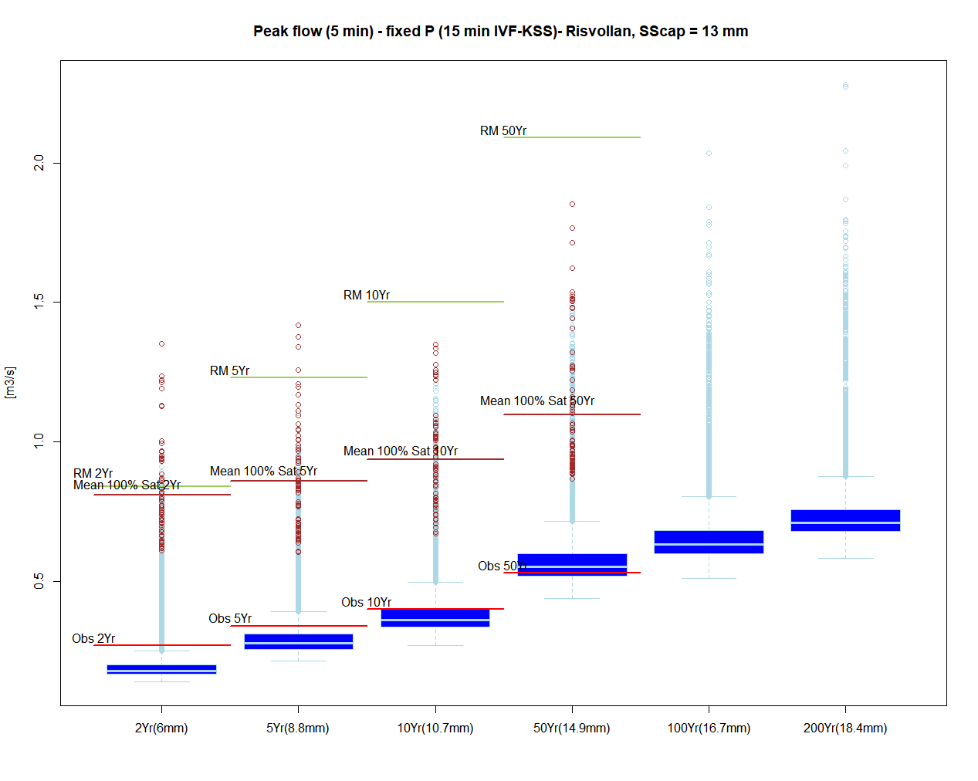
Rasjonelle metode:
180 000 m2, tc = 15 min = 900 sekunder
C = 0.7 (NVE, 10, 1997)
P2y(tc) = 6 mm
P5y(tc) = 8.8 mm
P10y(tc) = 10.7 mm
P50y(tc) = 14.9 mm
Q2Y = 0.7*0.006*180000/900=0.84 m3/s
Q5Y= 0.7*0.0088*180000/900=1.23 m3/s
Q10Y = 0.7*0.0107*180000/900=1.5 m3/s
Q50Y = 0.7*0.0149*180000/900=2.09 m3/s

Slide 20
Preliminary conclusions and further work/development
AMC appears to be VERY important for urban flooding
Return period of precipitation should NOT be used as proxy for the return period of urban floods (possibilities for huge overestimations)
Include snowmelt as a stochastic element in DDDEvent
More catchments
Investigate correlations between AMC and precipitation/snowmelt (through models) Ignoring correlations leads to underestimating of floods
Build the SCHADEX method for estimating urban design flood

Slide 21
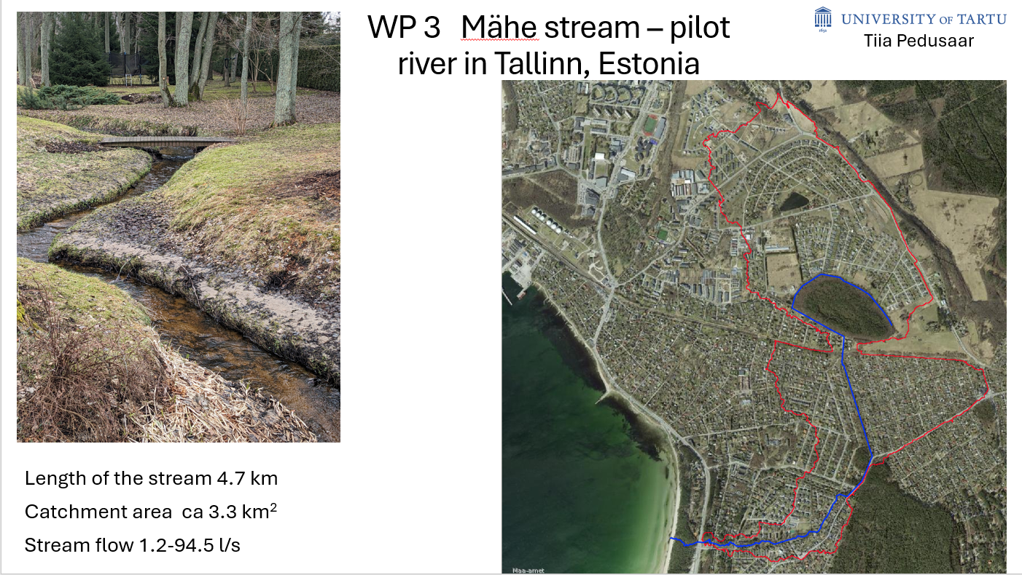
More catchments
Norway: four catchments: Sandsli, Risvollan , and Lillestrøm
Estonia: The Mähe stream (3.3 km2) in Tallinn
Denmark: Vejle (330 km2) and Køge (180 km2)
Data needs: precipitation, temperature and runoff at suitable temporal resolution (depends on spatial scale) and a fine resolution DTM

Slide 22
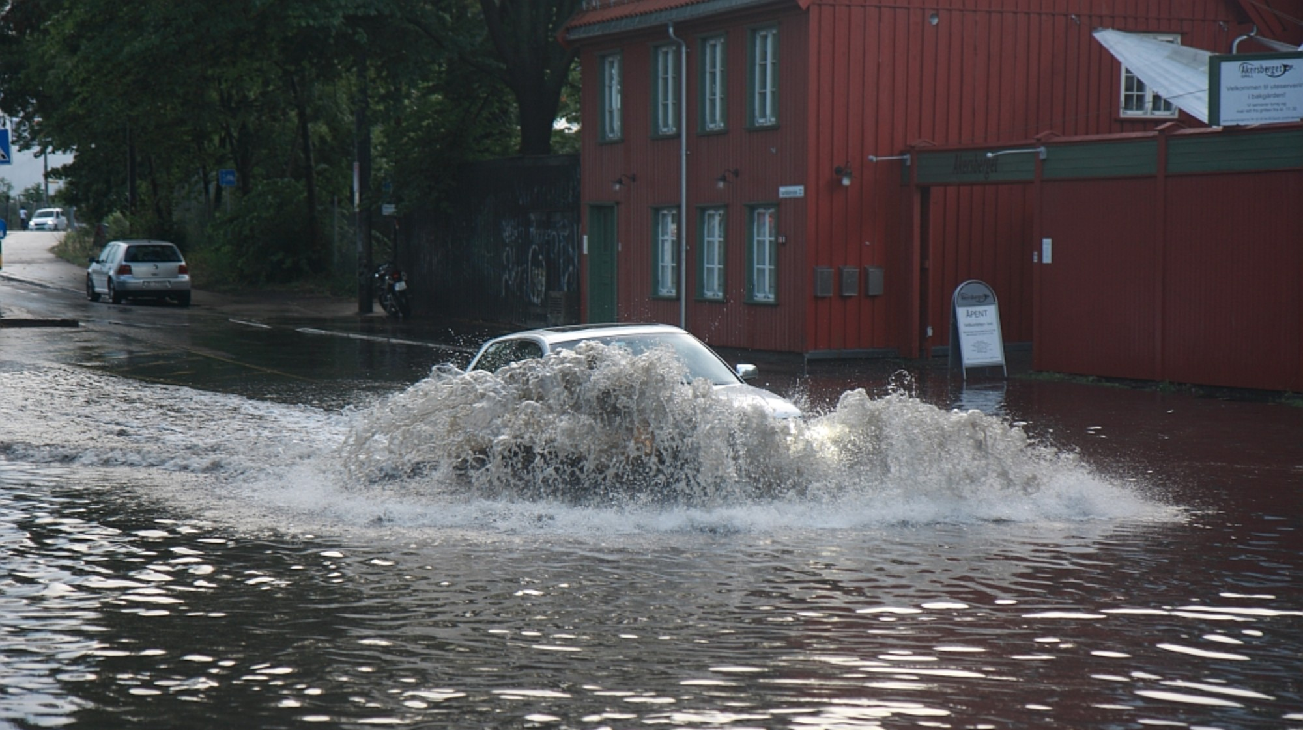
Thank you for your attention!
Foto: Thomas Widerberg
Notes:
Bytt gjerne ut med andre ikoner på slide 14-15

Slide 23
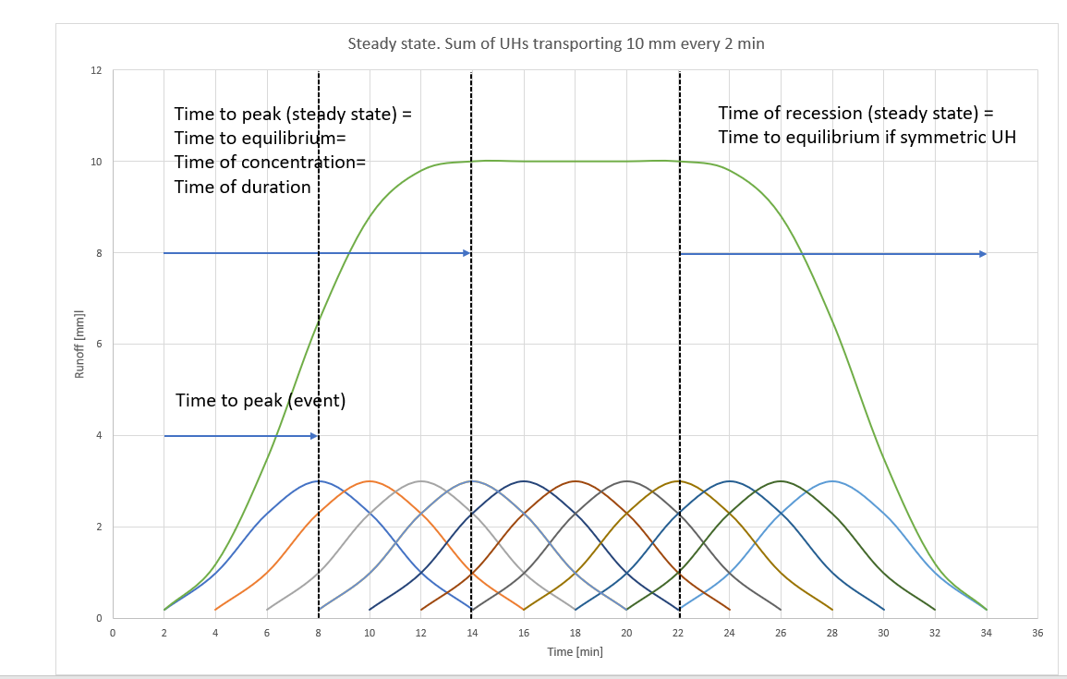
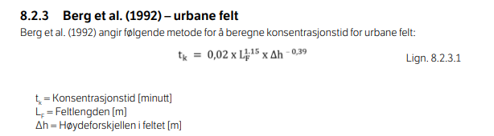
Time of concentration (= duration). From the litterature:
Glossary of Hydrology (WMO, 1974): «the period of time required for storm runoff to flow from the most remote part of a drainage basin to the outlet»
Beven, 2020 A history of the concept of time of concentration (HESS): Time to equilibrium, or, the time it takes for a pulse through the river network RN, which is the time it takes from the most remote part of the RN to the outlet

Slide 24
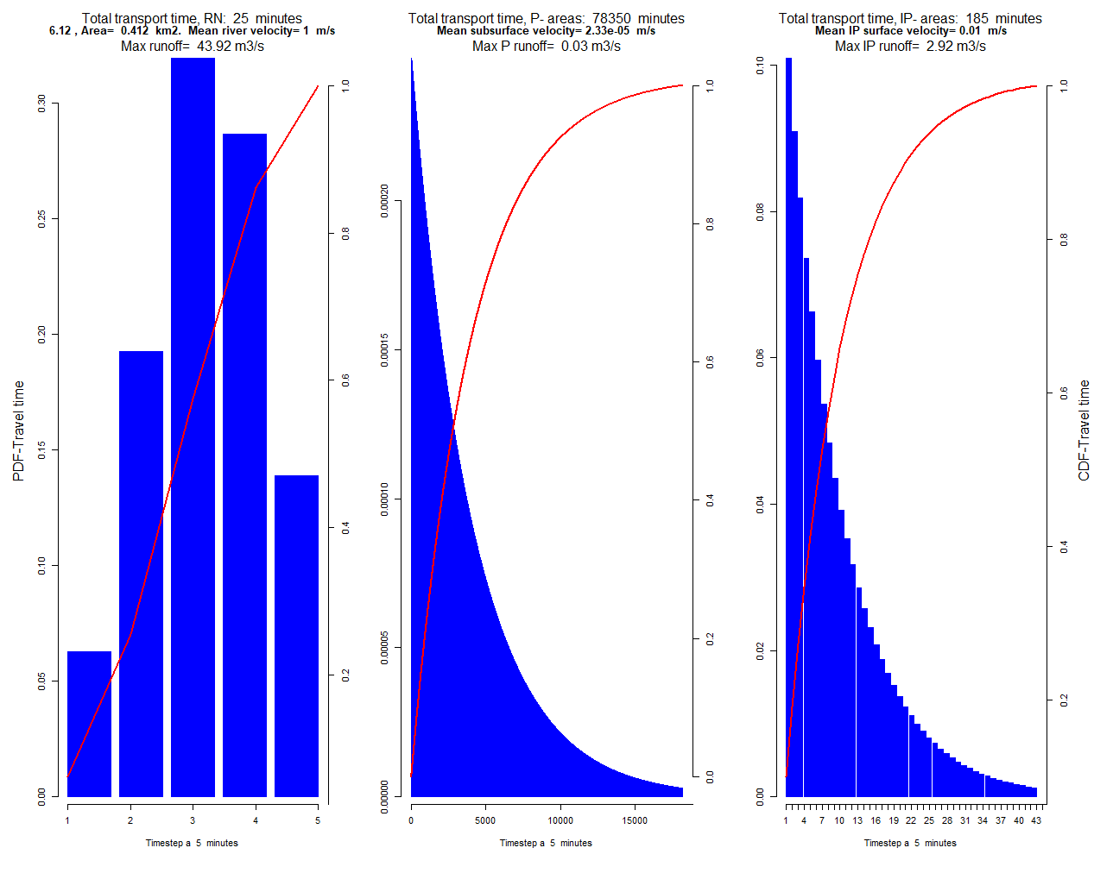
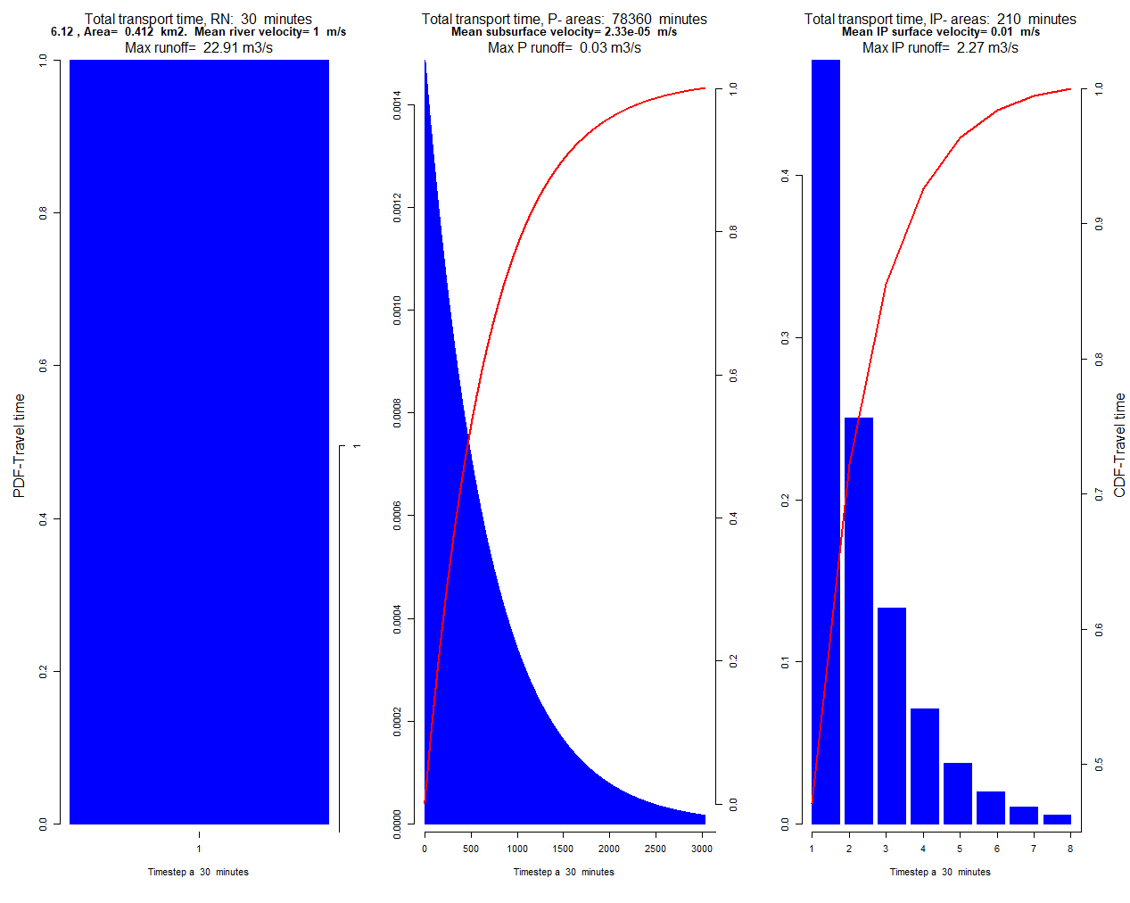
Temporal resolution $ΔT$ and floods
Too coarse temporal resolution (30 min)
OK temporal resolution (5min)

Slide 25
